Slide 1
Chapter 15
Chemical Equilibrium

Slide 2
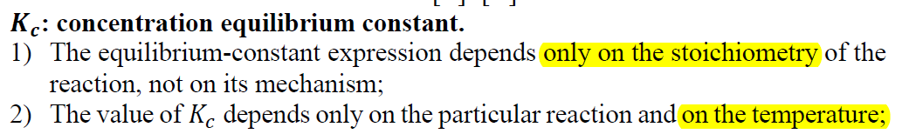
1. Which one of the following will change the value of an equilibrium constant? ________
A) changing temperature
B) adding other substances that do not react with any of the species involved in the equilibrium
C) varying the initial concentrations of reactants
D) varying the initial concentrations of products
E) changing the volume of the reaction vessel
A

Slide 3
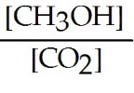
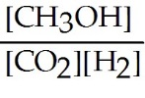
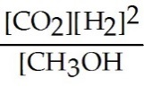
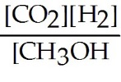
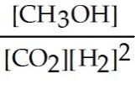
2. Which of the following expressions is the correct equilibrium-constant expression for the following reaction? ________
CO₂ (g) + 2H₂ (g) CH₃OH (g)
A) B)
C) D)
E)
E

Slide 4
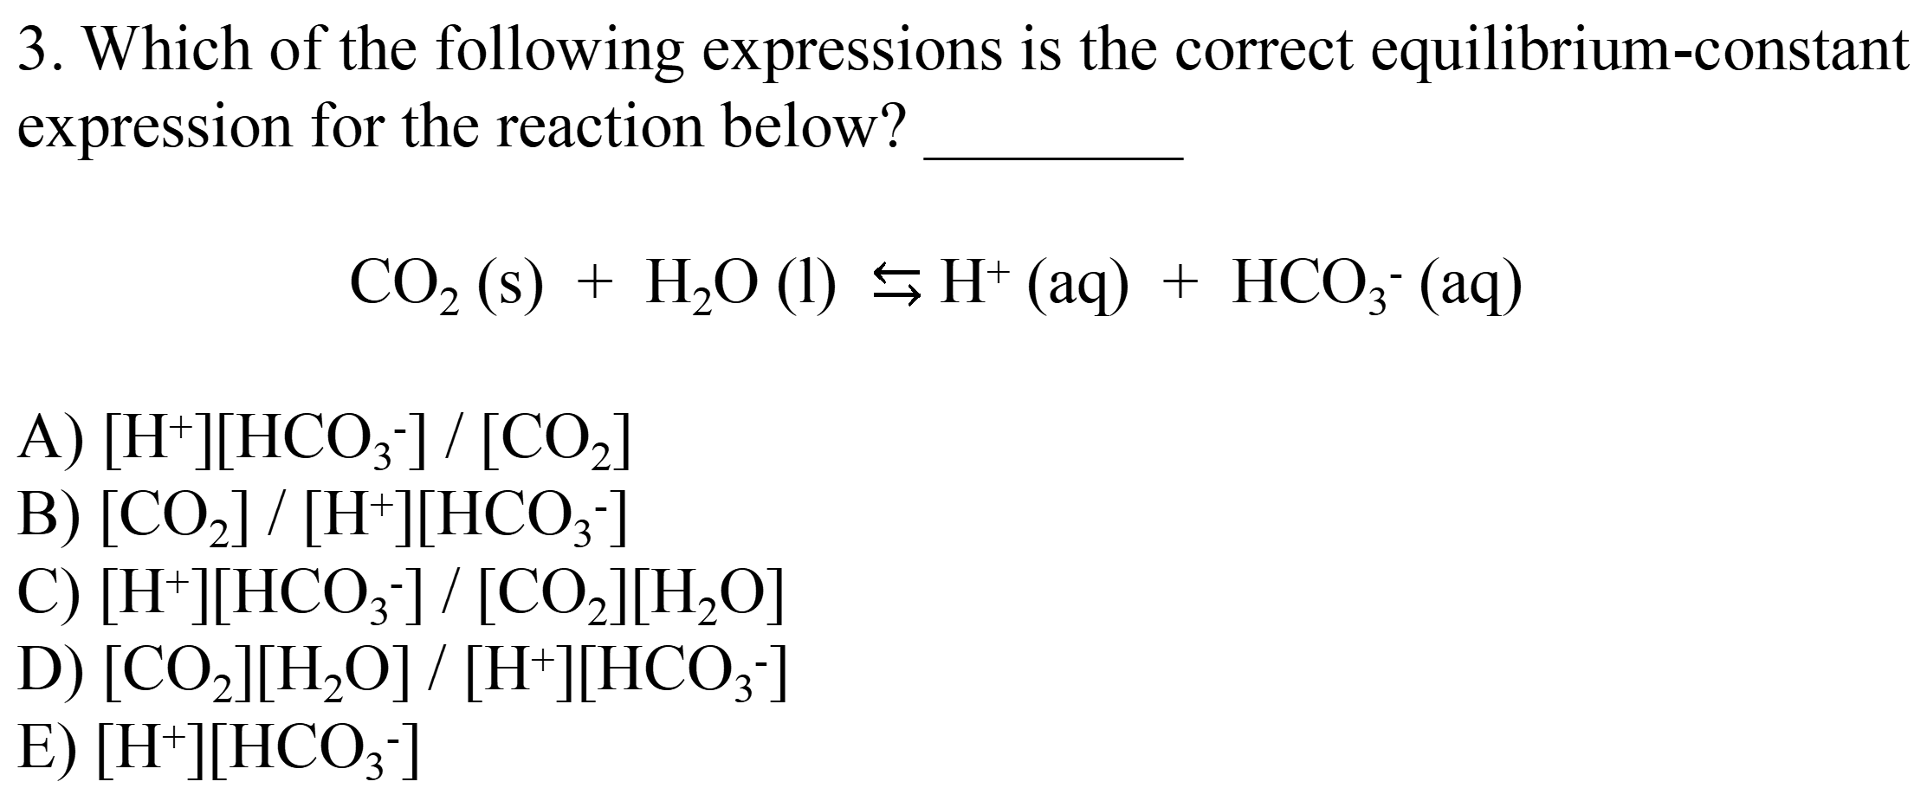
3. Which of the following expressions is the correct equilibrium-constant expression for the reaction below? ________
CO₂ (s) + H₂O (l) $⇆$ H⁺ (aq) + HCO₃⁻ (aq)
A) [H⁺][HCO₃⁻] / [CO₂]
B) [CO₂] / [H⁺][HCO₃⁻]
C) [H⁺][HCO₃⁻] / [CO₂][H₂O]
D) [CO₂][H₂O] / [H⁺][HCO₃⁻]
E) [H⁺][HCO₃⁻]
E

Slide 5
4. The equilibrium constant for reaction (1) is K. The equilibrium constant for reaction (2) is ________.
(1) SO₂ (g) + (1/2) O₂ (g) SO₃ (g)
(2) 2SO₃ (g) 2SO₂ (g) + O₂ (g)
A) K²
B) 2K
C) 1/2K
D) 1/K²
E) -K²
D

Slide 6
5. Given the following reaction at equilibrium, if Kc = 5.84 × 10⁵ at 230.0 °C, Kp = ________.
2NO (g) + O₂ (g) 2NO₂ (g)
A) 3.67 × 10⁻²
B) 1.41 × 10⁴
C) 6.44 × 10⁵
D) 2.40 × 10⁶
E) 2.41 × 10⁷
B

Slide 7
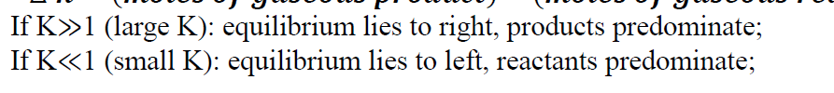
6. The equilibrium constant for the gas phase reaction
N₂ (g) + 3H₂ (g) 2NH₃ (g) is K_{eq} = 4.34 × 10⁻³ at 300 °C. At equilibrium, ________.
A) products predominate
B) reactants predominate
C) roughly equal amounts of products and reactants are present
D) only products are present
E) only reactants are present
B

Slide 8
7. Consider the following equilibrium.
2SO₂ (g) + O₂ (g) 2SO₃ (g)
The equilibrium cannot be established when ________ is/are placed in a 1.0-L container.
A) 0.25 mol SO₂ (g) and 0.25 mol O₂ (g)
B) 0.75 mol SO₂ (g)
C) 0.25 mol of SO₂ (g) and 0.25 mol of SO₃ (g)
D) 0.50 mol O₂ (g) and 0.50 mol SO₃ (g)
E) 1.0 mol SO₃ (g)
B

Slide 9
8. In which of the following reactions would increasing pressure at constant temperature change the concentrations of reactants and products, based on Le Châteliers principle? ________
A) N₂ (g) + 3H₂ (g) 2NH₃ (g)
B) N₂O₄ (g) 2NO₂ (g)
C) N₂ (g) + 2O₂ (g) 2NO₂ (g)
D) 2N₂ (g) + O₂ (g) 2N₂O (g)
E) all of the above
E

Slide 10
9. The Kp for the reaction below is 1.49×10⁸ at 100.0°C: CO (g) + Cl₂ (g) → COCl₂ (g). In an equilibrium mixture of the three gases, P_{CO} = P_{Cl2} = 1.00 × 10⁻⁴ atm. The partial pressure of the product, phosgene (COCl₂), is ________ atm.
A) 1.49
B) 1.49 × 10¹⁶
C) 6.71 × 10⁻¹⁷
D) 1.49 × 10⁴
E) 1.49 × 10¹²
A

Slide 11
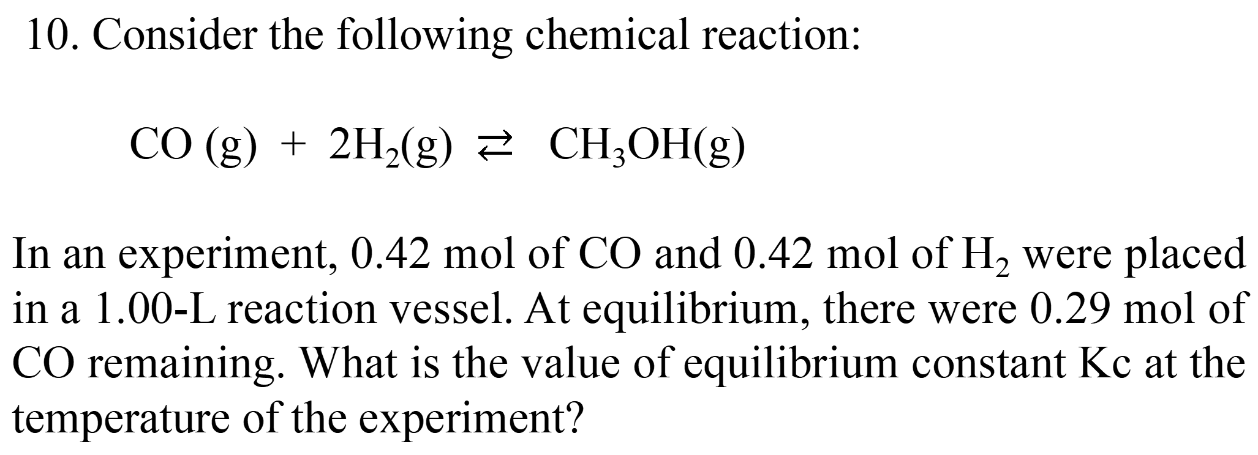
10. Consider the following chemical reaction:
CO (g) + 2H₂(g) $⇄$ CH₃OH(g)
In an experiment, 0.42 mol of CO and 0.42 mol of H₂ were placed in a 1.00-L reaction vessel. At equilibrium, there were 0.29 mol of CO remaining. What is the value of equilibrium constant Kc at the temperature of the experiment?
Answer: 17.5

